Slide 1
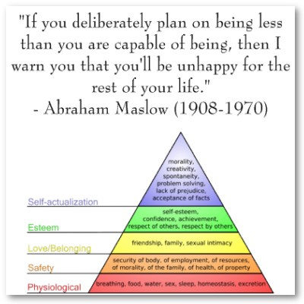
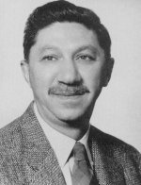
Abraham Maslow

Slide 2
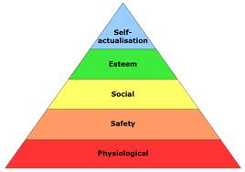
What is Maslow's Hierarchy of Needs?
Theory developed to rank needs of all people
Marks the development of people in stages
5 stages to complete self-understanding
Maslow's belief is if a person does not meet a stage, they cannot be fully self understood
You can not move on to the next without completing the one before
http://www.google.com/imgres?q=hierarchy+of+needs&um=1&hl=en&safe=active&gbv=2&tbm=isch&tbnid=0XcYODIN-L0C_M:&imgrefurl=http://summermgmt.wordpress.com/2011/06/28/maslows-hierarchy-of-needs-theory

Slide 3
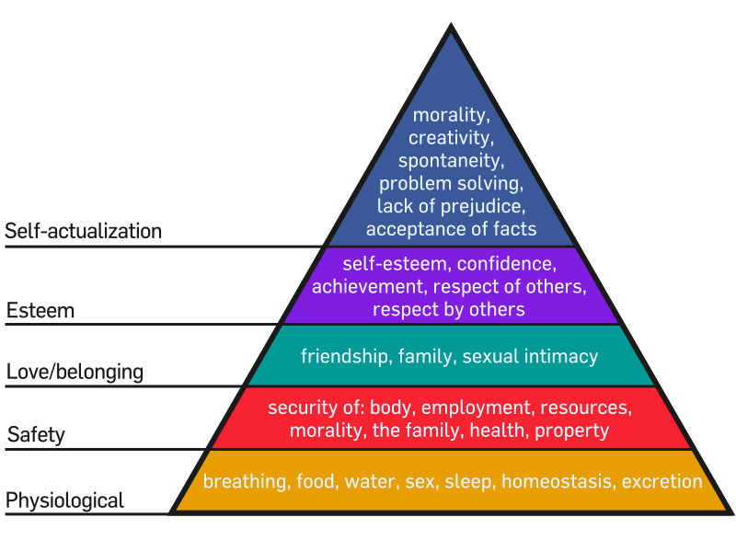
Maslow's Hierarchy of Needs

Slide 4
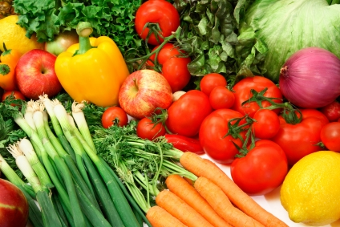
Physiological
Lowest level in basic needs
Daily, natural activities
Breathing, food, water, sleep, excretion
Most basic level of needs, cannot function without these
http://www.google.com/imgres?q=healthy+foods&um=1&hl=en&safe=active&gbv=2&tbm=isch&tbnid=xji8rXRfD3IAuM:&imgrefurl=http://www.healthyfoods.ws/&docid=9TLgrvgSPWvR5M&w=424&h=283&ei=ajV3TtPqGYfh0QGM543zDQ&zoom=1&iact=hc&vpx=835&vpy=449&dur=131&hovh=183&hovw=275&tx=136&ty=112&page=1&tbnh=136&tbnw=178&start=0&ndsp=28&ved=1t:429,r:18,s:0&biw=1440&bih=778

Slide 5
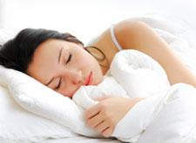
Physiological Positive vs. Negative
Positive Sleep More concentrated More aware of surroundings Able to focus better Food will keep you energized Feel secure and confident Trust http://www.google.com/imgres?q=energized+person&um=1&hl=en&safe=active&gbv=2&tbm=isch&tbnid=xBSZSYQ5-n0iGM:&imgrefurl=http://www.sleeprequired.com/2009/05/getting-a-better-nights-sleep-how-to-wake-up-feeling-energized | Negative Not enough sleep Not focused Slacking in school Very tired Poor diet Sense of inadequacy and self doubt Failure to develop trust can lead to a sense of fear and a belief that the world is inconsistent and unpredictable

Slide 6
Safety
2nd level of needs
Feeling safe and secure in one’s environment
Security of:
Body, recourses, morality, the family, health, property
Without feeling safe, this stage cannot be passed
Affecting factors:
Loss of job, lacking sense of security, illnesses

Slide 7
Safety Positive vs. Negative
Positive Secure in life and personal decisions Feel comfortable taking risks and trying new things Daily routines and rhythms make life easier | Negative Illness Anxious or unsafe in normal situations Lacking sense of security Uncomfortable with surroundings All things feel unpredictable, and minor risks and decisions feel extreme

Slide 8
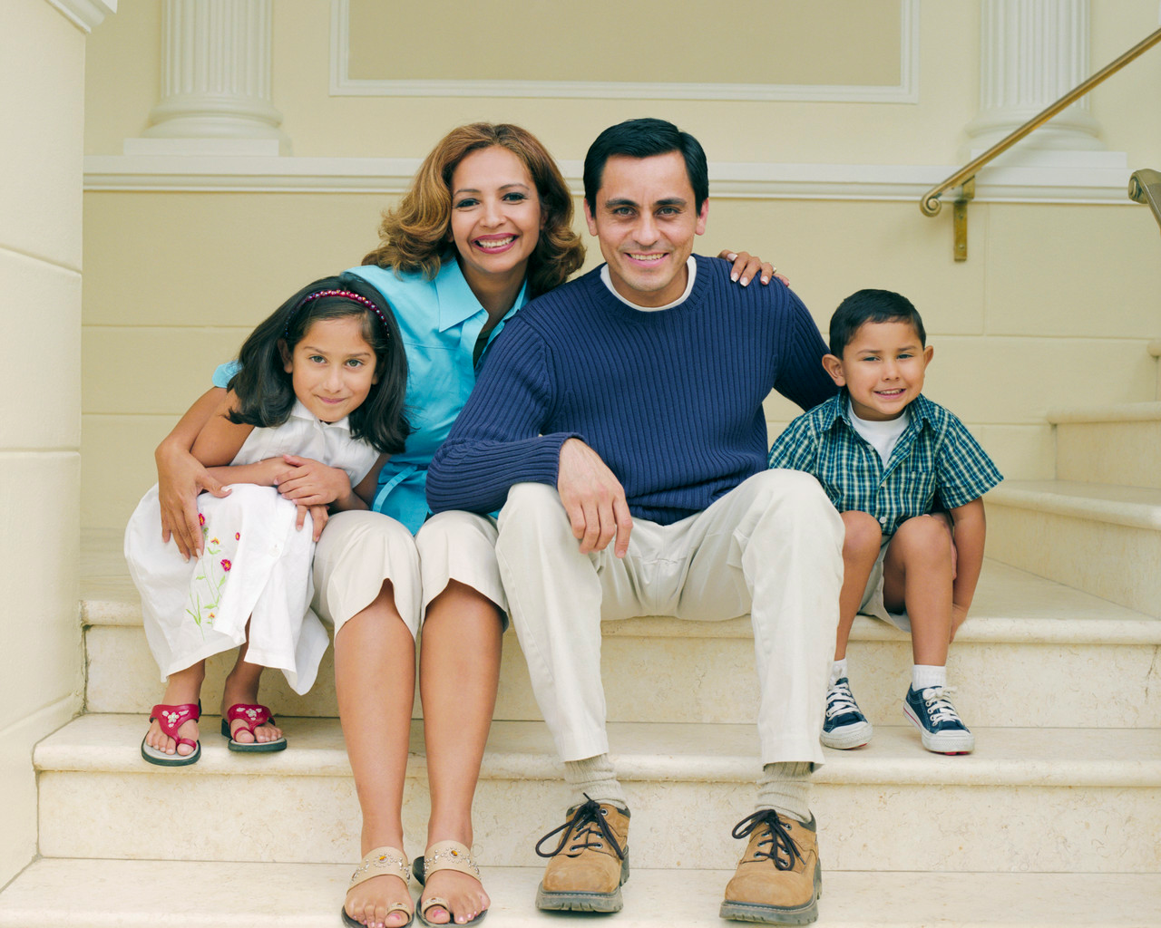
Love/ Belonging
3rd level in pyramid
Belonging, feeling needed
Friendship, family, sexual intimacy
http://www.google.com/imgres?q=family&um=1&hl=en&safe=active&gbv=2&tbm=isch&tbnid=BtHf9OPhajBR9M:&imgrefurl=http://www.lcmh.com/family-medicine&docid=3Q4og7QZfZU9AM&w=1280&h=1024&ei=CzN3TqywO8fg0QHHkPmiDQ&zoom=1&iact=rc&dur=393&page=1&tbnh=137&tbnw=178&start=0&ndsp=28&ved=1t:429,r:8,s:0&tx=132&ty=52&biw=1440&bih=778

Slide 9
Love/Belonging Positive vs. Negative
Positive Work well with others Able to feel comfortable around others Content with environment | Negative Not wanting to be around others Not focusing well Example: school work/etc. Lower self esteem Depression

Slide 10
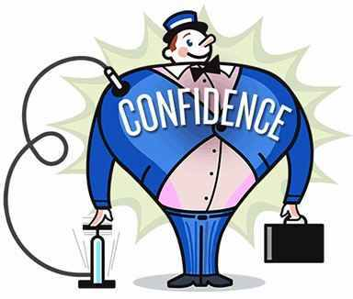
Esteem
4th level in pyramid
Self esteem, confidence, achievement, respect of others, respect by others
http://www.google.com/imgres?q=positives+of+good+self+esteem&um=1&hl=en&safe=active&sa=N&gbv=2&tbm=isch&tbnid=LANc92gDc7pqTM:&imgrefurl=http://www.psychologytoday.com/blog/making-change/200910/how-high-self-esteem-can-get-us-down&docid=-ocMfOLT62_-RM&w=384&h=326&ei=mDJ3Tpb-8

Slide 11
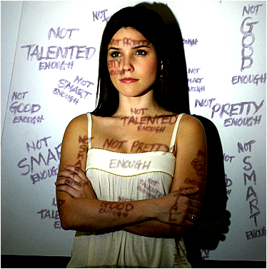
Esteem Positive vs. Negative
Positive Confidence in oneself Respect Greater happiness Able to accomplish more | Negative Doubtful Insecure Uncertain about everything
http://www.google.com/imgres?q=self+esteem&hl=en&safe=active&gbv=2&tbm=isch&tbnid=tQolbMR20rmHqM:&imgrefurl=http://crazifornia.com/tag/self-esteem

Slide 12
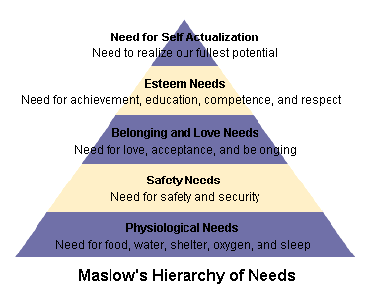
Self actualization
Final, and top stage of pyramid – the goal of self knowledge
This level is only reached when all other levels are achieved
Morality, creativity, problem solving, lack of prejudice, acceptance of facts, satisfaction with self and life, interest in working for justice, not self-serving

Slide 13
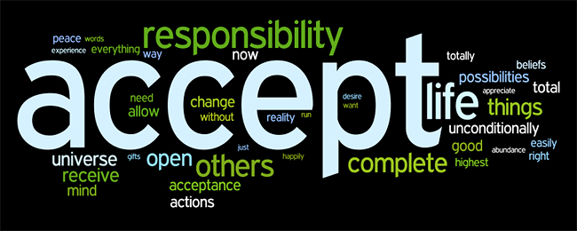
Self actualization Positive vs. Negative
Positive Acceptance of self, others and nature Realism Self-fulfillment Spontaneity http://www.google.com/imgres?q=acceptance&um=1&hl=en&safe=active&sa=N&gbv=2&tm=isch&tbnid=15-_PhNCIJ9afM:&imgrefurl=http://acorporatechics.blogspot.com/2011/05/lesson-of-acceptance.html&docid=7ocK-8DQMpQXOM&w=650&h=260&ei=hTh3ToaYN-jd0QGFjKTDDQ&zoom=1&iact=rc&dur=318&page=1&tbnh=75&tbnw=188&start=0&ndsp=28&ved=1t:429,r:12,s:0&tx=77&ty=51&biw=1440&bih=778 | Negative Not focused on problems out side of himself, doesn’t see justice Can’t really help society

Slide 14
Question 1
Why is self-esteem so important for people?

Slide 15
Answer 1
It is important to have self-esteem and worth. Accomplishments can only happen if you believe in yourself and feel good about yourself

Slide 16
Question 2
What need did Maslow consider to be the most basic?

Slide 17
Answer 2
Physiological – basic food, water, shelter, clothing – what you truly can’t live without. You can’t focus on learning or interacting with others if you are hungry, cold, or in fear.

Slide 18
Question 3
Why are the belonging needs so vital for human development?

Slide 19
Answer 3
Everyone needs and wants to feel loved and part of a group, be it family or social. We are a community structured people.

Slide 20
Question 4
Why is the highest level and last step to completing the hierarchy of needs so hard to achieve?

Slide 21
Answer 4
Self-actualizing is difficult because people don’t always want to look beyond caring about themselves, they are only concerned about self.

Slide 22
Question 5
What are some examples of security needs?

Slide 23
Answer 5
Desire for steady employment, health insurance, safe neighborhoods and shelter from the environment.

